Slide 1
Recap of DATA 180
Derek, Ashley, Selene, Alissa

Slide 2
Visualizations
Numerical Variables
Single variable (Univariate)
Two variables (Bivariate)
Categorical Variables

Slide 3
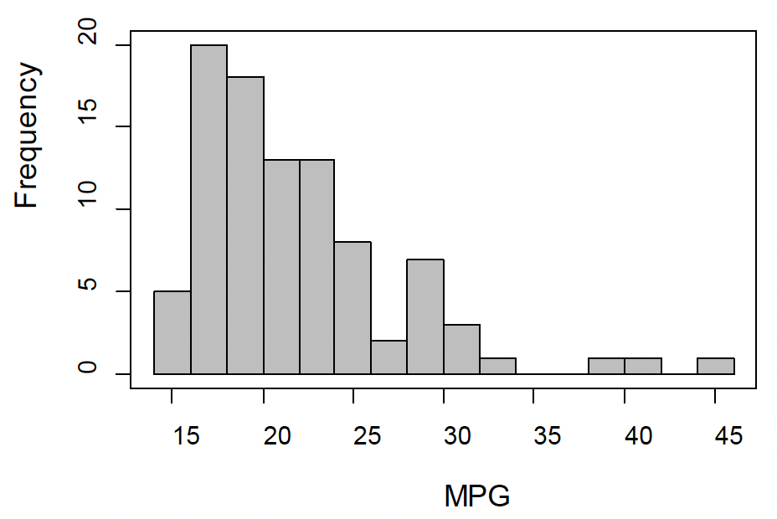
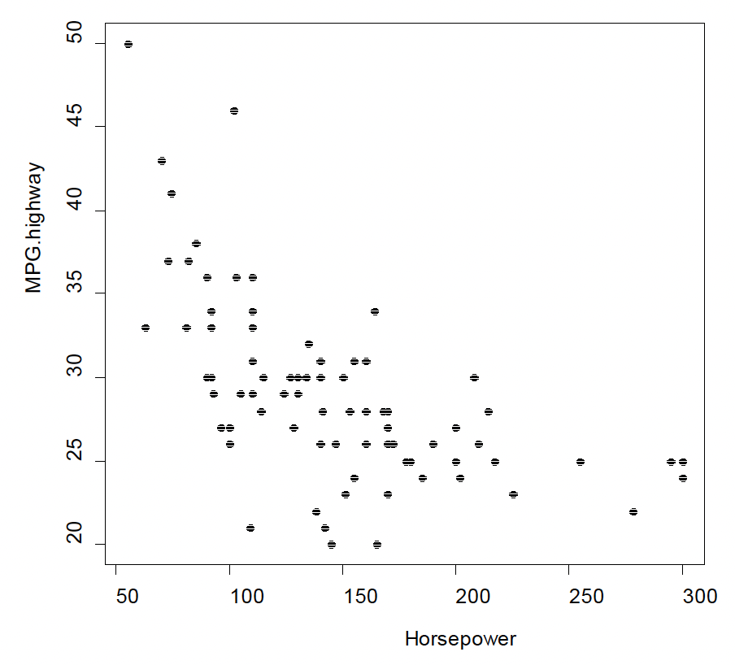
Visualizations Numerical Variables
Single Variable:
Histograms
Stem-and-Leaf plots
Dotplots
Bivariate Data:
Scatterplots

Slide 4

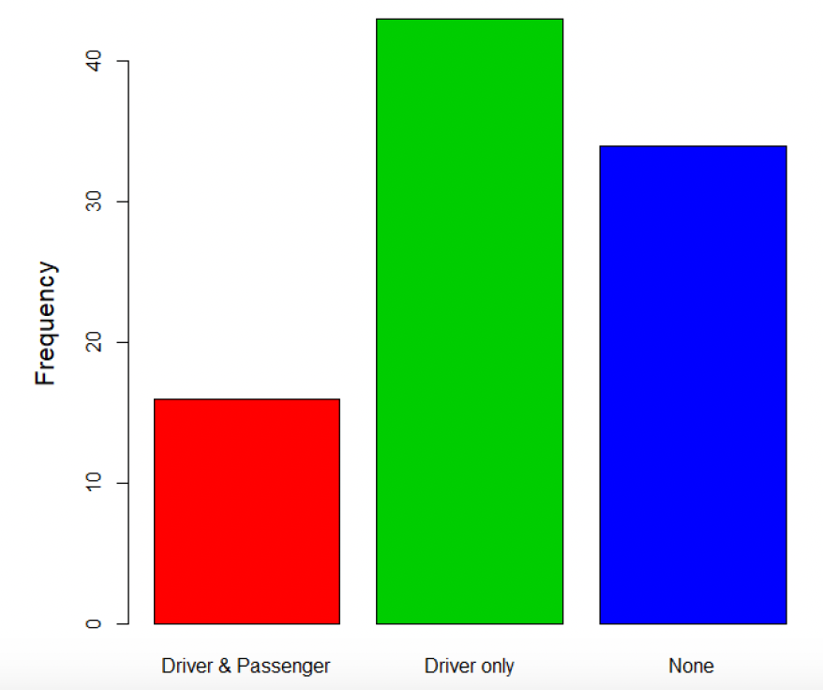
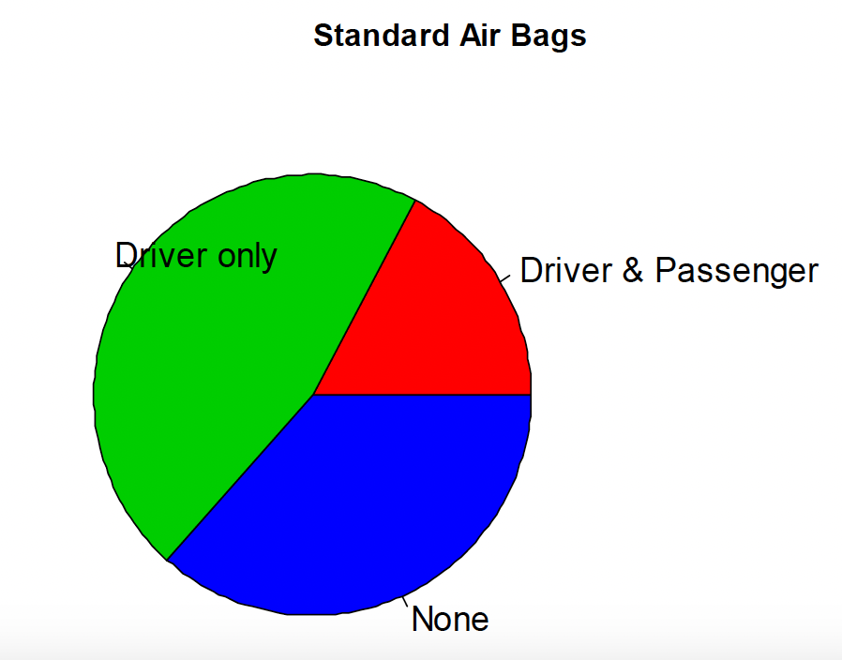
Visualizations Categorical Variables
Bar graphs
Pareto charts, side-by-side bar graphs
Pie charts

Slide 5
Data Wrangling
Step | Description | Function
Loading Data | Importing data from various sources | read.csv(), read_excel()
Handling Missing Data | Detect and manage missing values | is.na(), na.omit(), impute()
Filtering/Subsetting | Extract specific rows/columns | subset(), filter()
Transforming Data | Modify or create new variables | mutate(), scale()
Reshaping Data | Change data structure (wide/long formats) | pivot_longer(), pivot_wider()
Merging Data | Combine multiple datasets | merge(), left_join(), right_join()
Grouping/Summarizing | Group and calculate summary statistics | group_by(), summarize(), aggregate()
Spelling Correction |  | OpenRefine

Slide 6
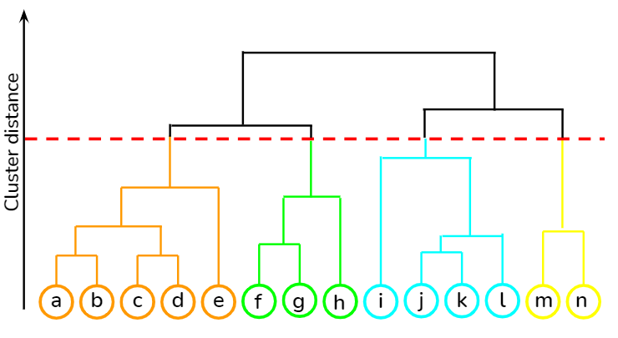
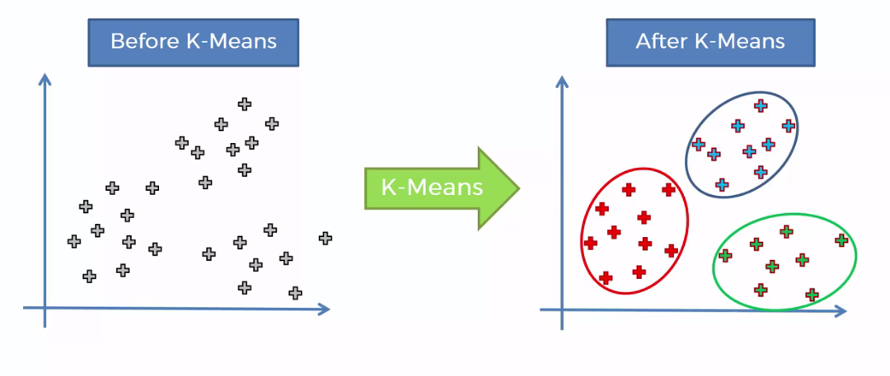
Unsupervised Learning
Goal is to uncover patterns and insights within unlabeled data
Techniques Learned
K-means clustering
Hierarchical clustering
Other concepts
Similarities between clusters

Slide 7
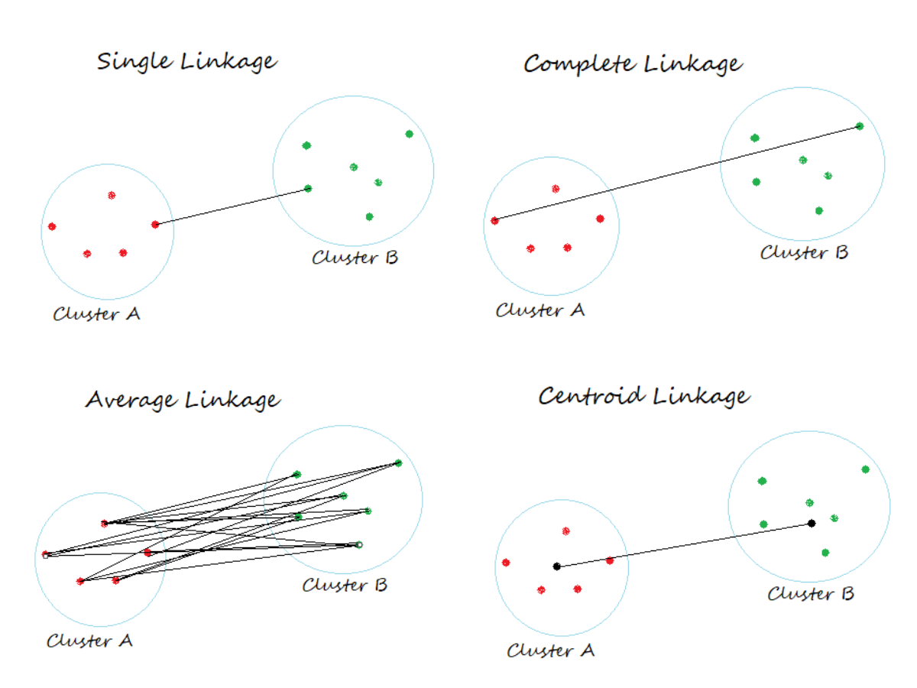
K-means and Hierarchical Clustering
We assign each data point into a specific number of clusters k
Objective is to minimize the sum of distances between the data points and the cluster centroid
Similarity between clusters
When creating a dendrogram, there are different ways to calculate the similarity between clusters:
Single Linkage
Complete Linkage
Average Linkage
Centroid Linkage

Slide 8
Supervised Learning
Supervised learning is a collection of models that uses a set of variables (predictors) to predict a variable of interest (response variable).
2 types of response variables: classification and regression
Models:
- Linear Regression
- Logistic Regression

Slide 9

Linear Regression
Linear regression is to assume a linear relationship between the predictors and the response.
Objective is to minimize residuals, specifically minimizing the sum of squared residuals a.k.a Ordinary Least Squared (OLS) Method

Slide 10
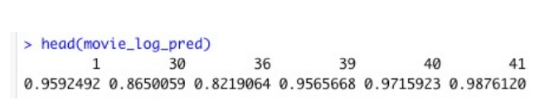
Logistic Regression
Used to model binary outcomes, where the dependent variable is categorical with two possible outcomes (e.g., 0 or 1, yes or no, true or false).
Logistic regression predicts the probability of an event occurring.
How do you read this output?

Slide 11
Dickinson Farm - Ideas
Using K-means clustering to identify target groups of customers for Dickinson farm, using the insight to construct customer personas.
Using supervised learning to uncover the how various business factors (internal and external) affect sales.

Slide 12
Discussion Questions
What are some limitations to using the K-means algorithm?
How do you balance the need for data accuracy with the risk of over-cleaning or altering data too much during the wrangling process, particularly in cases where some 'messiness' might carry important contextual information?
Notes:
Challenges arise with larger data sets where the number of clusters we want to create is unknown. Outliers can impact the clusters and centroids, making it less accurate.

